Slide 1
Lit Element
Easily Create Fast, Lightweight Web Components

Slide 2
Content
Web Components – Standards
LitElement
Other Libraries

Slide 3

<template> elements -> Reuse DOM
Custom Elements -> Connects JS Classes to HTML Tags
Shadow DOM -> Hides you from rest of the page
JavaScript Modules -> To package and publish components

Slide 4
<template> Element -> Reusable UI
It lets to define snippets of HTML and aren’t added to document until cloned by JavaScript.
Parsed once and cloned whenever required (cheap operation)
Demo 1 : https://jsfiddle.net/anuragpathak1991/tbLa12kw/16/
Demo 2 : https://jsfiddle.net/anuragpathak1991/kc24rws7/6/

Slide 5
Custom Elements – v1
Custom HTML tags
Inherits complete DOM API
Demo: https://jsfiddle.net/anuragpathak1991/7bnau0p5/4/
https://html.spec.whatwg.org/multipage/indices.html#element-interfaces

Slide 6
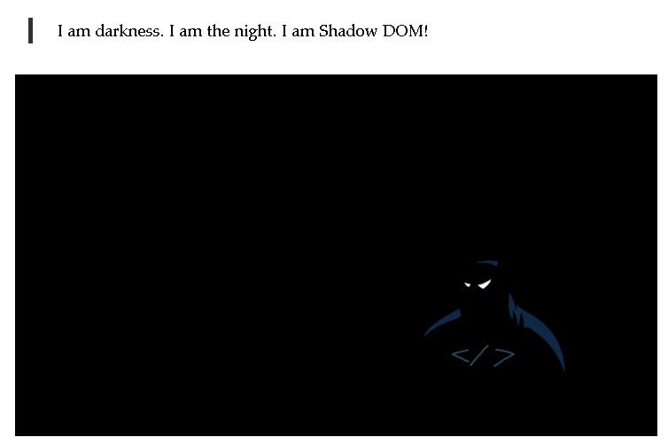
Shadow DOM
https://dev.to/bennypowers/lets-build-web-components-part-1-the-standards-3e85#template-elements

Slide 7
Shadow DOM Cont..
Encapsulated DOM tree
Anyone can drop any web component in there page without worrying about any side effect.
Demo: https://jsfiddle.net/anuragpathak1991/fg6vmh2b/9/
Links: https://meowni.ca/posts/part-theme-explainer/

Slide 8
ES6 Modules
Standard way to structure our apps

Slide 9
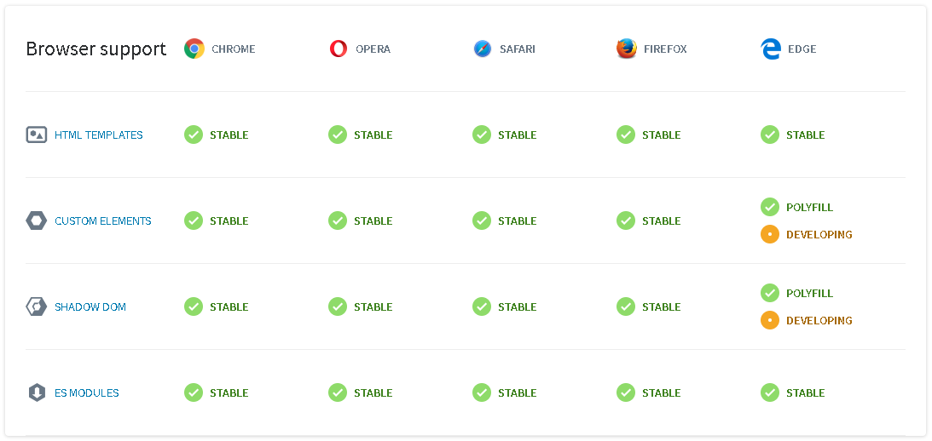
https://www.webcomponents.org/

Slide 10
Lit Element
Vanilla JS Lifecycle
Tagged Template Literal
Lit-html
Some examples…

Slide 11
Lifecycle – Vanilla JS Web Components
contstructor -> When element is created
connectedCallback -> Every time elements connects to DOM
attributeChangedCallback -> Whenever any attributes changes
disconnectedCallback -> before element is removed from DOM
adoptedCallback -> Whenever we call adoptNode on CustomElement which in another Dom or documentfragment
Demo: https://jsfiddle.net/anuragpathak1991/ko3td452/10/

Slide 12
Vanilla Components Pros and Cons
Pros | Cons
No dependencies needed. Your code is future-proof because it rests on web standards instead of library churn. | You'll need to provide your own helpers. Syncing properties with attributes might become cumbersome.
Small loading footprint since no extra roundtrips for library code are necessary | 0-dep components don't leverage mixins or helper libraries to reduce filesizes in large projects.
No non-standard APIs to learn, maintain, or adapt to. It's just the web. | Low level web primitives can sometimes be cumbersome.
Low-level power gives you control and flexibility. You can factor your components however you want. | You have to go out of your way to support polyfill browsers, whereas with the libraries, polyfill limitations and known issues are abstracted away.
https://dev.to/bennypowers/lets-build-web-components-part-3-vanilla-components-4on3

Slide 13
Tagged Template Literals
Uses back tick – not single or double quotes
Can have expressions
Can be passed to a special function called tag where it will have static and variable parts separate.
Demo 1: https://jsfiddle.net/anuragpathak1991/c3fqzj8h/
Demo 2: https://jsfiddle.net/anuragpathak1991/5vnyqepm/
Demo 3: https://jsfiddle.net/anuragpathak1991/d4uwqj86/

Slide 14
Lit Element
Functional UI
Data Binding
Directives – until / repeat / ifDefined
Demo 1: http://127.0.0.1:8081/examples/Ex4-lit-html.html
Demo 2: http://127.0.0.1:8081/examples/Ex5-lit-html.html

Slide 15
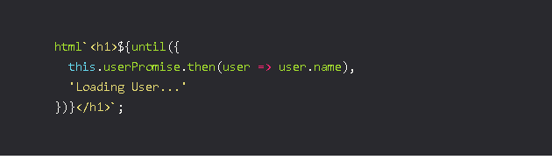

Slide 16
LitElement
Uses lit-html for rendering
Unidirectional Data flow

Slide 17
Example 1 : Properties/Loops/Conditions
How to render property in a component.
If some DOM comes in LOOP
Conditional Rendering
Demo: http://127.0.0.1:8081/examples/Ex6-LitElement.html

Slide 18
Example 2 : Properties/Loops/Conditions
Text Content
Attribute
Boolean Attribute
Property
Event Handler
Demo: http://127.0.0.1:8081/examples/Ex6-LitElement.html

Slide 19
Example 3: Compose a template from other template
Create whole UI as different functions.
Reuse template literals
Demo: http://127.0.0.1:8081/examples/Ex8-LitElement.html

Slide 20
Recommended Styling Approach
Use CSS style tag from lit-element
Demo : http://127.0.0.1:8081/examples/Ex9-LitElement.html

Slide 21
Properties - Accessors
For each property a corresponding attribute is created
Reflect -> property to be reflected to attribute
myProp: { attribute: false}

Slide 22
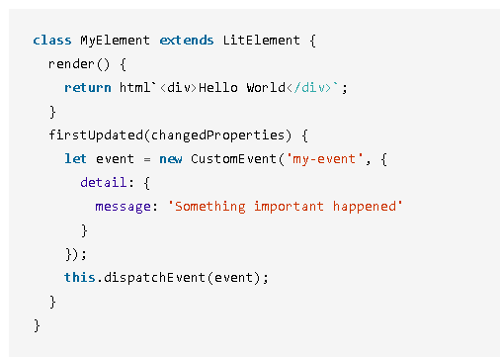
Fire Events

Slide 23
Redux + LitElement
Easy to configure due to one way data binding
Demo : http://127.0.0.1:8081/examples/Ex10-LitElement.html

Slide 24
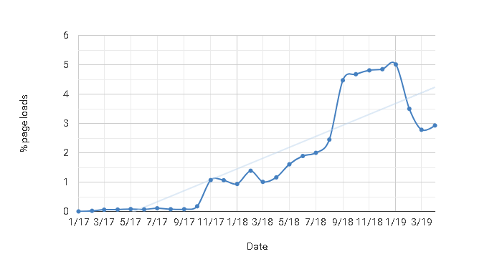
custom elements v1 (5%) – All Page Loads
https://www.chromestatus.com/metrics/feature/timeline/popularity/1689

Slide 25
Other Libraries
Stencil JS https://stenciljs.com/ (JSX + CustomElements)
GLUONJS https://github.com/ruphin/gluonjs
Hybrids JS https://hybrids.js.org/ ( class and this – more of pure functions)

